Slide 1
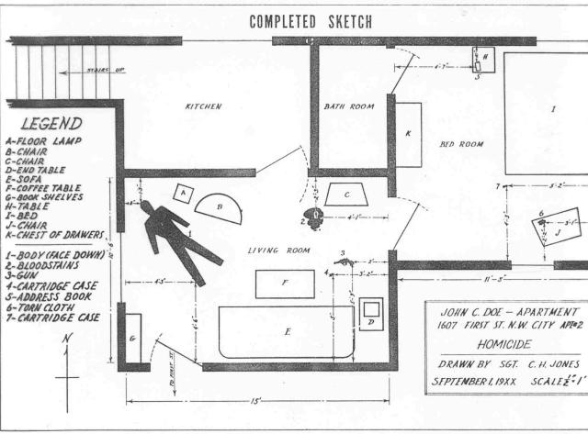
Crime Scene Sketches

Slide 2
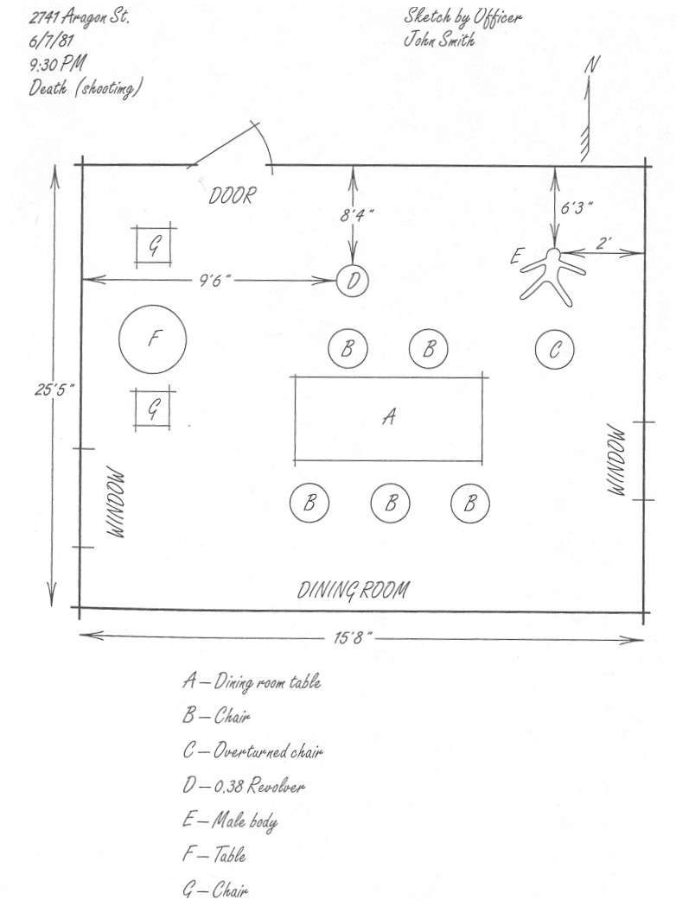
Once the scene has been photographed, the investigators will need to ___________ the crime scene.
SKETCH

Slide 3
Rough Sketch
Rough sketches contain
measurements of the
entire scene. If there is a
body or other pertinent
evidence, measurements
are taken from two fixed
points.

Slide 4
The most critical step in the process of creating a crime scene diagram is accurately measuring the position of every item depicted in the rough sketch. Every item included in the rough sketch should be measured from one or more reference points. The number will depend upon the method used to measure the scene. Before any measurements are taken, the measurement method must be determined and reference points must be established.

Slide 5
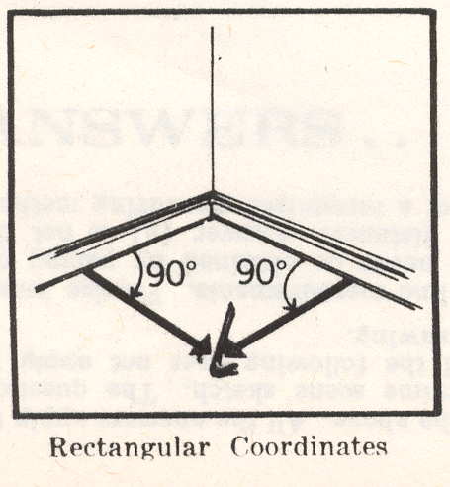
MEASUREMENTS
Rectangular coordinates
  Useful in sketching indoor crime scenes
  Two measurements are made at right angles of an item to the nearest two permanent objects (usually walls)
  Crowbar (ouch!)

Slide 6
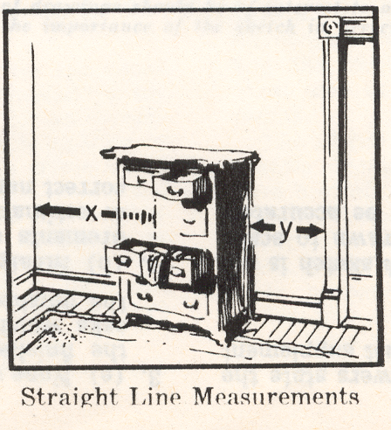
STRAIGHT LINE MEASUREMENTS
Usually made of furniture or evidence on a wall
Two measurements are taken, one from each side of the object
Slob

Slide 7
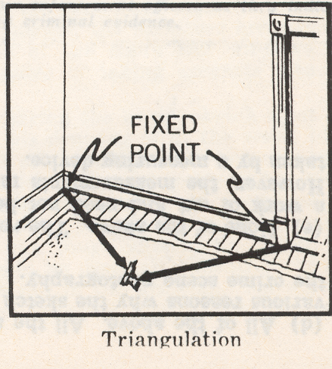

TRIANGULATION
May be used indoors or outdoors
Two fixed points are selected as points of reference
Measurements taken from the object to each point forming a triangle

Slide 8
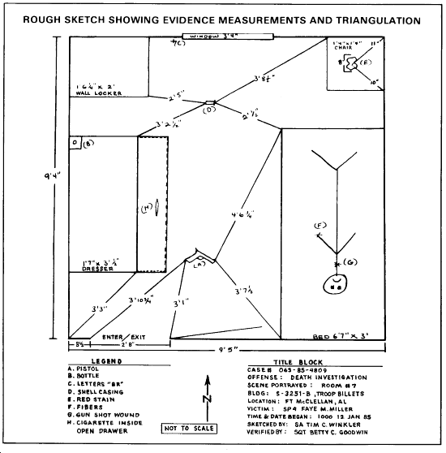

Slide 9
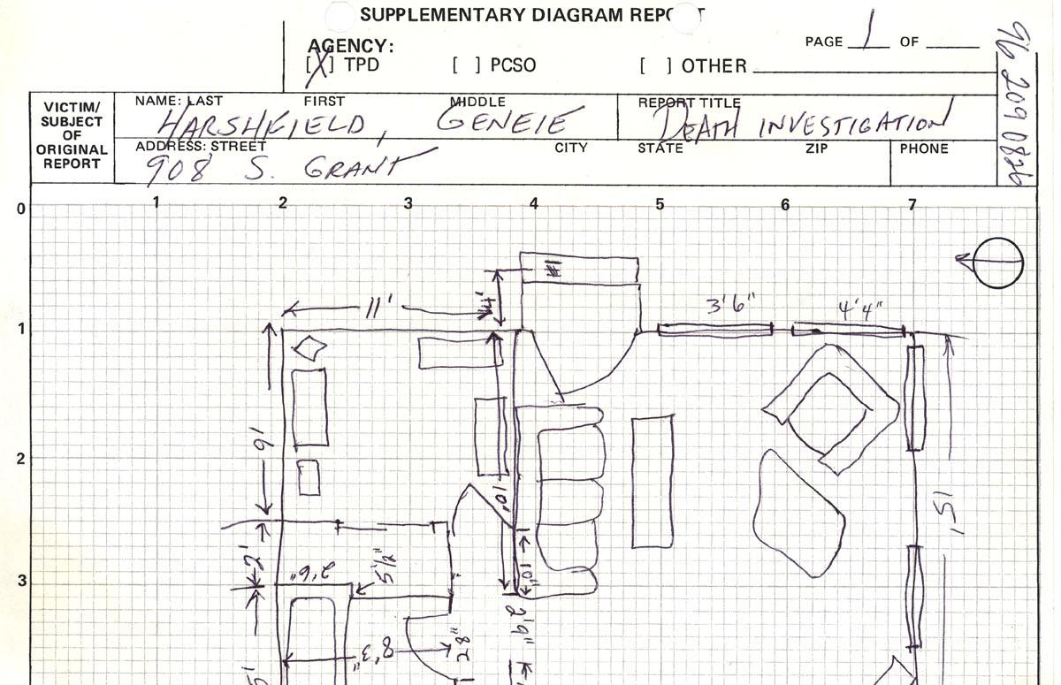
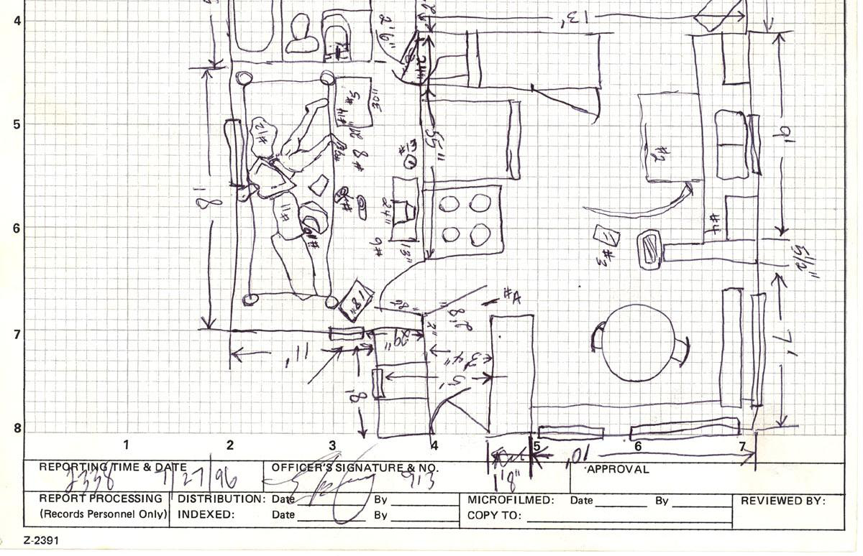

Slide 10
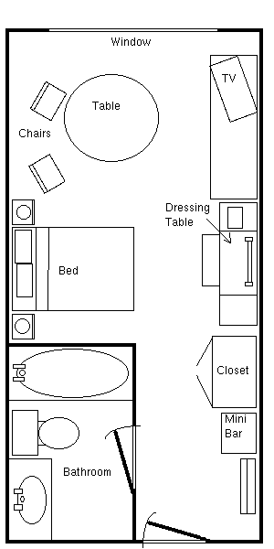
The rough sketch will later produce a finished crime scene sketch to scale (usually one-eighth of an inch equals one foot for indoor scenes and 1 inch equals 20 feet for outdoor scenes).

Slide 11
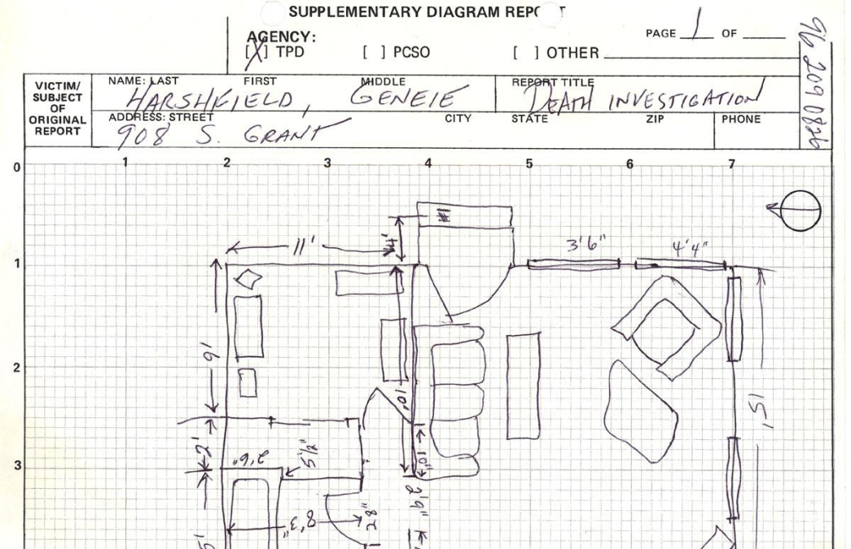
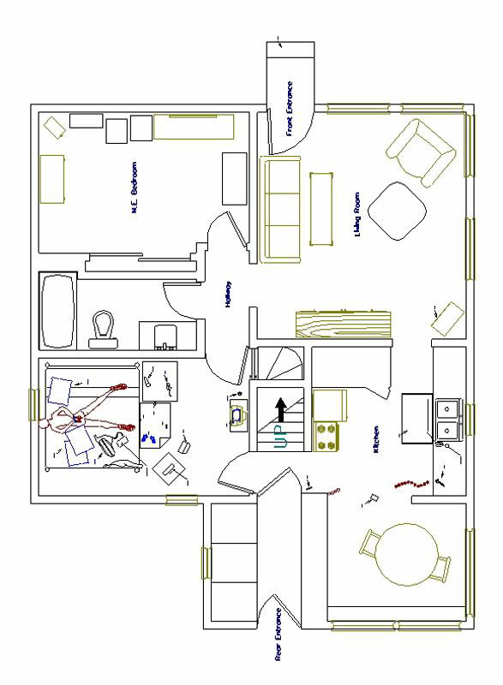
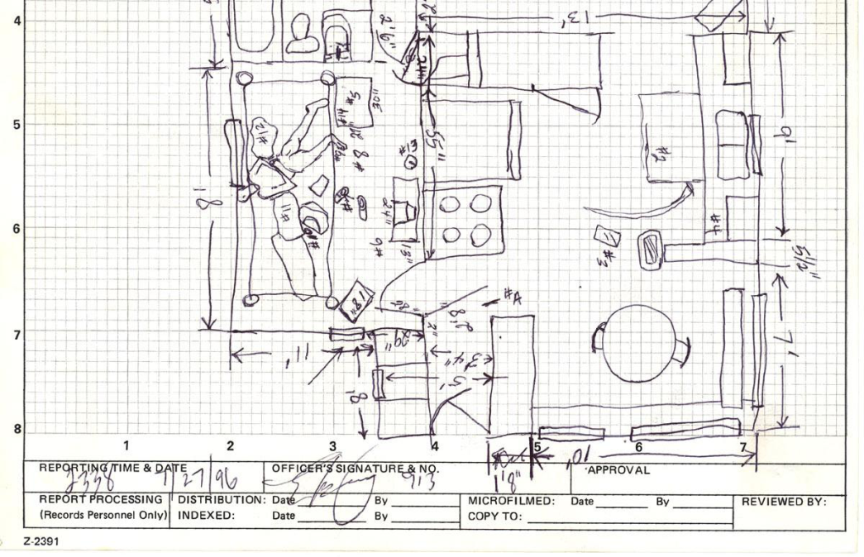

Slide 12
The Finished Scale Drawing
The finished scale drawing is done in ink and on a good grade of paper.
Investigators will not be drawing a sketch to scale at the crime scene.

Slide 13
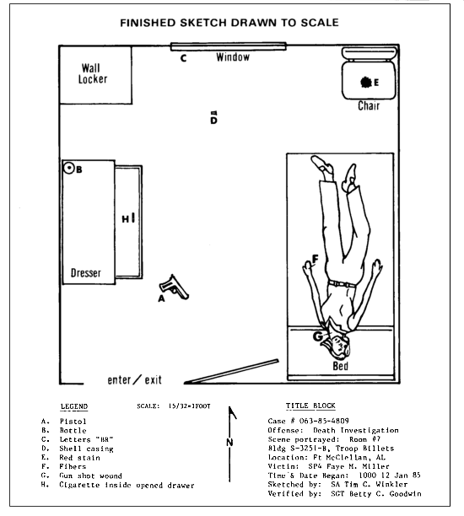

Slide 14
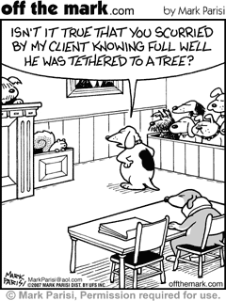

What is the purpose of a finished sketch?
To be presented in court

Slide 15
Tacoma Police Department - Forensic Services Policy and Procedure Manual
A crime scene sketch will be completed at the crime scene. The sketch and accompanying notes will contain accurate and complete measurements and descriptions for all elements within the sketch. Crime scene sketches and measurements will be recorded in a neat and orderly manner. A crime scene diagram, drawn to scale and based upon the measurements contained in the crime scene sketch, will be completed using the Section’s Computer Aided Design (CAD) software1, within 4 weeks, unless otherwise directed by a Forensic Services Supervisor. The scale used to print the final crime scene diagram will be handwritten on the back of the diagram and a copy will be forwarded to LESA records for inclusion in the case file. Crime scene sketches and/or notes will not be substituted for a scale diagram, but will be retained as part of the discovery process.

Slide 16
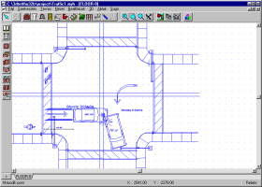
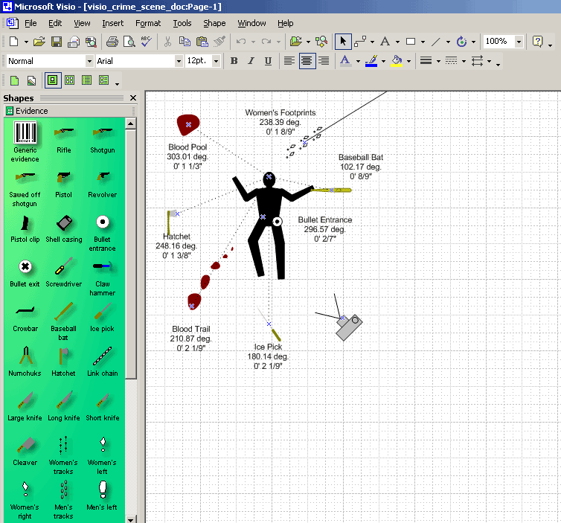
Computer Assisted Drawing
Many companies have developed computer hardware to assist in drawing a crime scene.

Slide 17
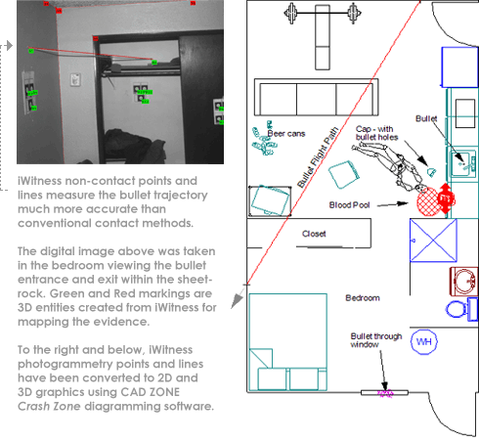
CAD
Computer-Aided
Drafting
Computer-Assisted
Drawing
Computer –Aided
Design

Slide 18
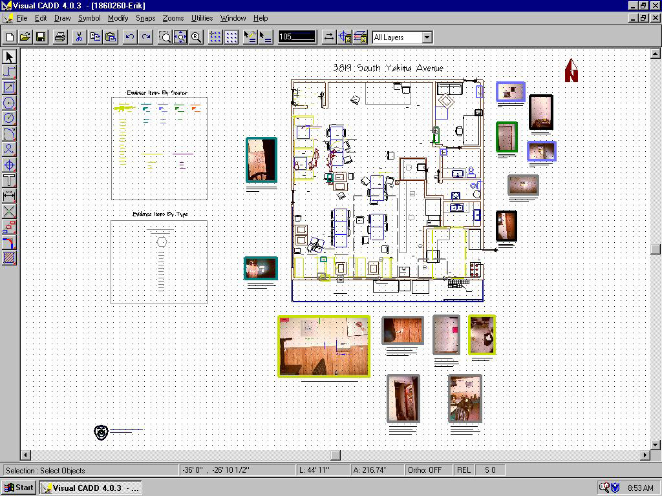

Slide 20
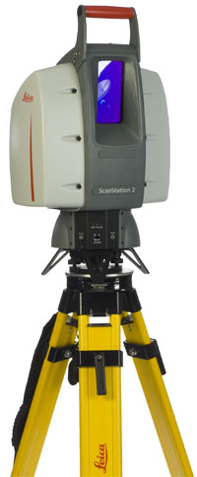
Leica Geosystem
3D laser scanning for forensics, public safety, and homeland security. A powerful tool for investigations and preplanning.

Slide 21
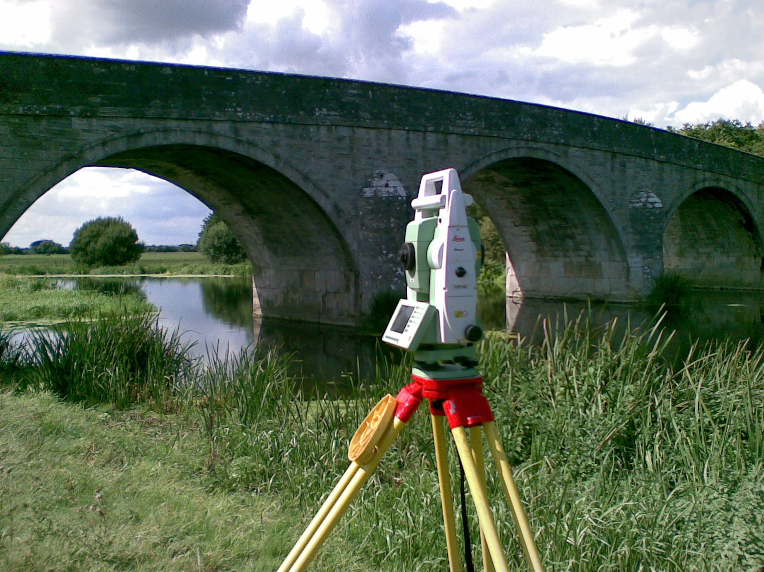
The Leica system is a very accurate 3D laser scanning system which uses a high-speed laser and a built-in digital camera to rapidly photograph and measure a scene exactly the way in which the first responder encountered it. It measures up to 900 feet, making it an ideal tool for law enforcement and public safety officials to document and archive complex environments.

Slide 22
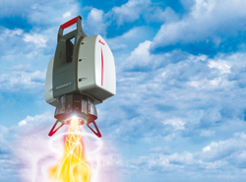
The system collects both photographic and measurement data. The photo captured is a high-resolution “full-dome” spherical photo of the scene which users can navigate and zoom into. The measurement data captured by the scanner is called a “point cloud” and investigators can use this information to easily determine any desired dimension at any time, even years after the event.

Slide 23

T h a t ‘ s a l l f o l k s~

